Slide 1
Helicopter Summit – “Enhancing Connectivity through Helicopters”
Development of MRO in India
Constraints and Issues
7th September , 2019
Helicopter Summit - 2019

Slide 2
Helicopter Summit – “Enhancing Connectivity through Helicopters”
Introduction.
Global Aviation Scenario - Passenger Air Travel & Cargo Services.
Raising Cost.
Global MRO Scenario.
Status of Indian Aviation.
Issues that Create Headwind for Indian Aviation & MRO - Needs Immediate Attention.
Conclusion.
Helicopter Summit - 2019

Slide 3
Helicopter Summit – “Enhancing Connectivity through Helicopters”
Aviation Industry experiencing unparalleled growth.
Expansion in the global population able to afford air travel.
Rising incomes and consumer spending .
Passenger travel grows to record levels and fuelling the highest fleet growth since 2008.
Next decade, air travel demand is anticipated to be robust.
Growth in Revenue Passenger Kilometres (RPK) exceeds the annual expansion of Gross Domestic Product (GDP) in most economies – high growth areas like China and India.
Helicopter Summit - 2019

Slide 4
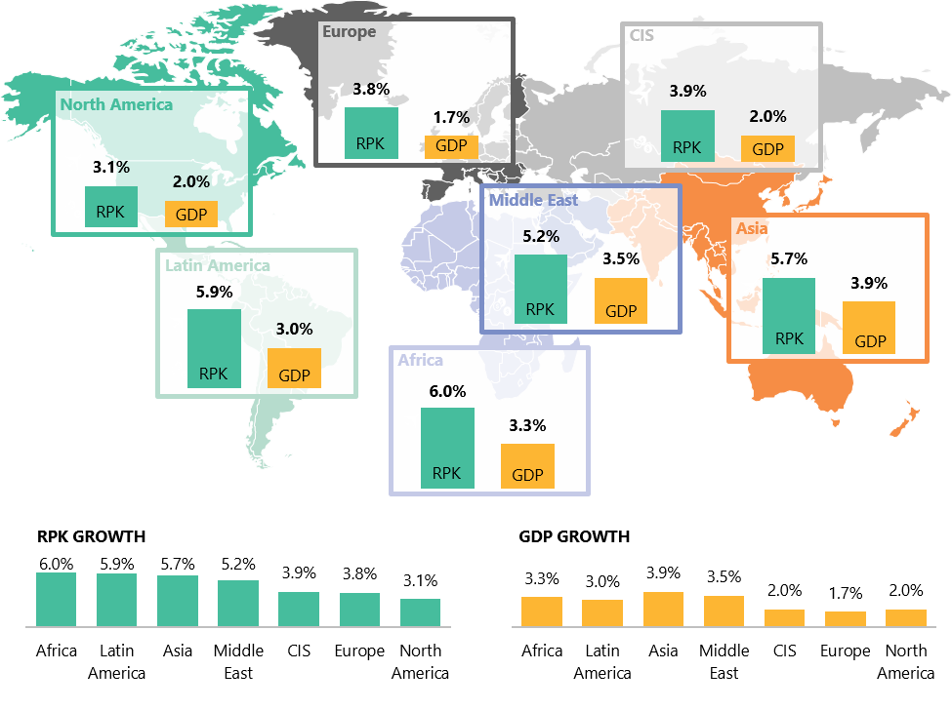
Helicopter Summit – “Enhancing Connectivity through Helicopters”
YEAR RPK AND GDP ANNUAL GROWTH RATE PROJECTIONS
Helicopter Summit - 2019

Slide 5
Helicopter Summit – “Enhancing Connectivity through Helicopters”
One out of every 20 Civil Aircraft that are delivered globally are for India.
India is the fastest growing aviation market for close to three years now.
Third largest domestic market and inching towards taking over Japan in the overall size of the market.
US and China, are still ahead of India, and it is expected that India would catch up by 2030.
Helicopter Summit - 2019

Slide 6
Helicopter Summit – “Enhancing Connectivity through Helicopters”
 | Global MRO | Indian MRO | Domestic MRO Done | Helicopter MRO/Indian MRO | Helicopters MRO / Domestic MRO Done
2019 | $82 billion | $ 2 billion/ 2.4% | $ 0.7 billion/30% | $ 75 million/(3.75%) | $ 75 million/10.7%
2029 | $116 billion | $ 4 billion/3.4% | $ 1.2 billion (30%) $ 2 billion (50%) | $ 150 million (3.75%) $ 600 million (15%) | $ 150 million/12.50% $ 600 million (30%)
Helicopter Summit - 2019

Slide 7
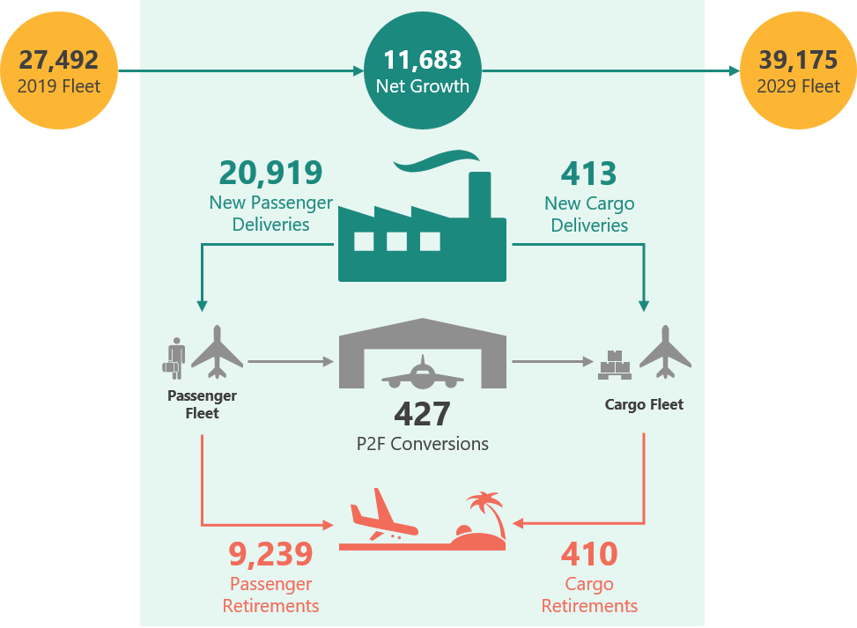
Helicopter Summit – “Enhancing Connectivity through Helicopters”
2019–2029 :: GLOBAL FLEET CHARACTERISTICS
 | 2019 | 2024 | 2029
FLEET SIZE | 27,492 | 33,295 | 39,175
5-YEAR CAGR | N/A | 3.9% | 3.3%
AVERAGE AGE | 11.3 | 10.9 | 10.7
Helicopter Summit - 2019

Slide 8
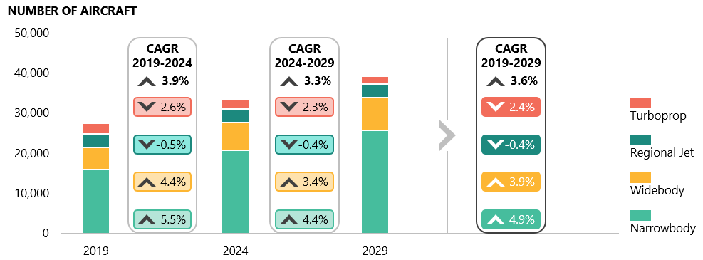
Helicopter Summit – “Enhancing Connectivity through Helicopters”
GLOBAL FLEET FORECAST BY AIRCRAFT CLASS, 2019–2029
Helicopter Summit - 2019

Slide 9
Helicopter Summit – “Enhancing Connectivity through Helicopters”
Boeing and Airbus historically maintaining high monthly production.
Committed to producing 50-60 per month in 2019.
Committed to producing 60-75 per month in 2020.
Late deliveries of fuselage components and engines have caused OEM production delays.
Delays prompted carriers to defer formal retirements.
Helicopter Summit - 2019

Slide 10
Helicopter Summit – “Enhancing Connectivity through Helicopters”
Cargo
Cargo volume growing, due to double-digit expansion of e-commerce.
Air cargo demand as measured by freight tonne kilometres (FTK) saw an estimated 3.8% increase in 2018.
Cargo capacity saw an estimated 4.4%.
Helicopter Summit - 2019

Slide 11
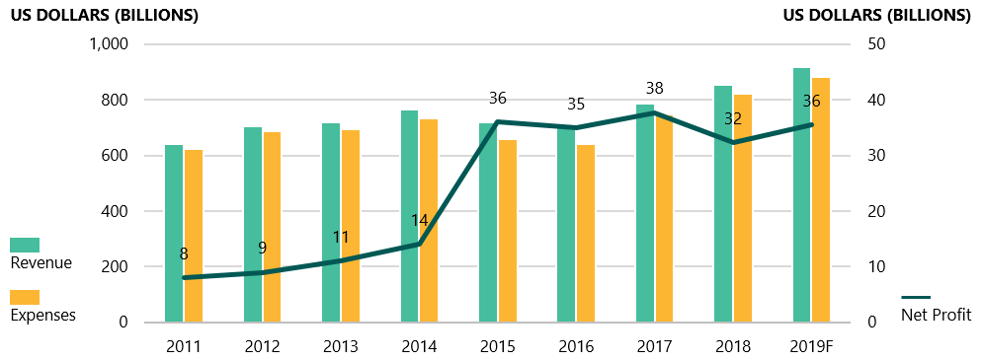
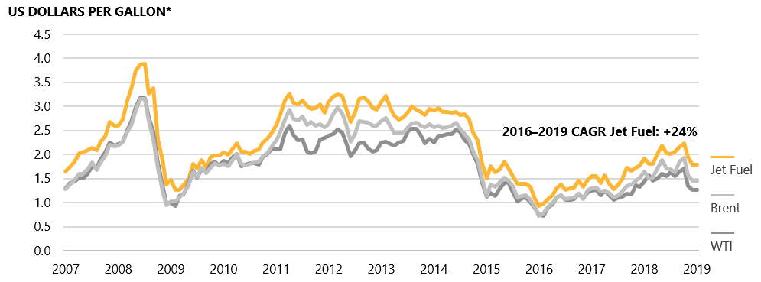
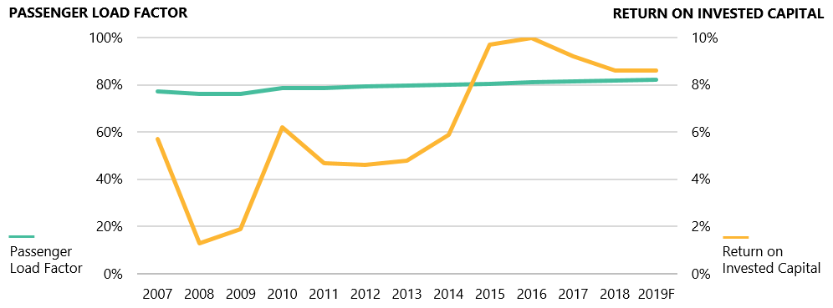
Helicopter Summit – “Enhancing Connectivity through Helicopters”
GLOBAL AIRLINE INDUSTRY FINANCIAL PERFORMANCE
SPOT PRICES OF CRUDE OIL AND JET FUEL PER GALLON
GLOBAL PASSENGER LOAD FACTOR VERSUS RETURN ON INVESTED CAPITAL
Helicopter Summit - 2019

Slide 12
Helicopter Summit – “Enhancing Connectivity through Helicopters”
Labour costs also have been on the rise.
Upward pressure on wages is expected with the need for more pilots and trained aviation maintenance technicians.
Labour and fuel are the industry’s two largest operating expenses.
Aviation industry will need 635,000 new commercial pilots by 2037. Presently, there are 550,000 full-time commercial pilots of which large numbers Old Guards (born between 1946 and 1964) and majority are expected to retire within the next 10 years.
Helicopter Summit - 2019

Slide 13
Helicopter Summit – “Enhancing Connectivity through Helicopters”
Aviation maintenance Engineers (AMEs) are older than workers in other industries, such as technology, retail, and healthcare.
Challenge of being an AME is to service older aircraft built before 2000 as well as newer planes with more sophisticated technology.
Operating expenses are putting pressure on airline profitability.
World GDP growth rate is expected to remain at 3.7 % for 2019.
China and India, while still growing at more than 6%, may also see slow economic growth over the next two years.
Helicopter Summit - 2019

Slide 14
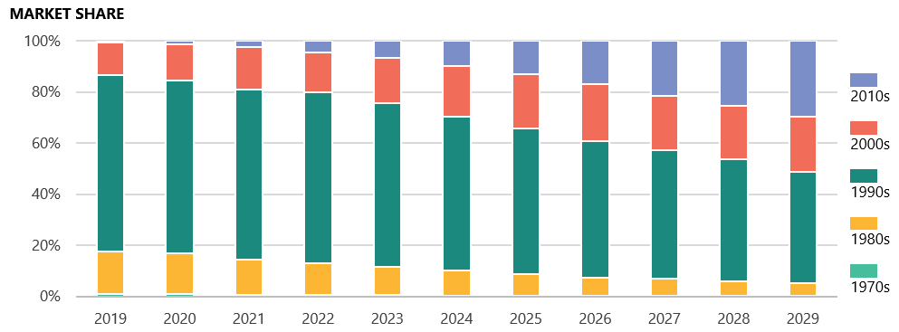
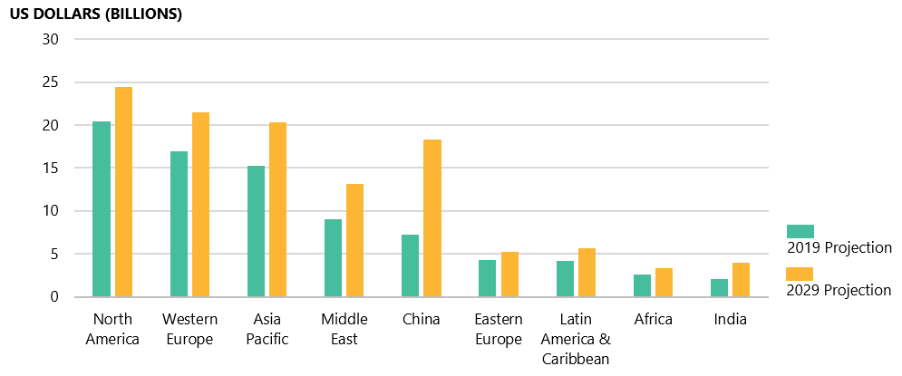
Helicopter Summit – “Enhancing Connectivity through Helicopters”
TOTAL MRO SPEND BY AIRCRAFT VINTAGE, 2019–2029
TOTAL MRO SPEND BY REGION, 2019 VERSUS 2029
Helicopter Summit - 2019

Slide 15
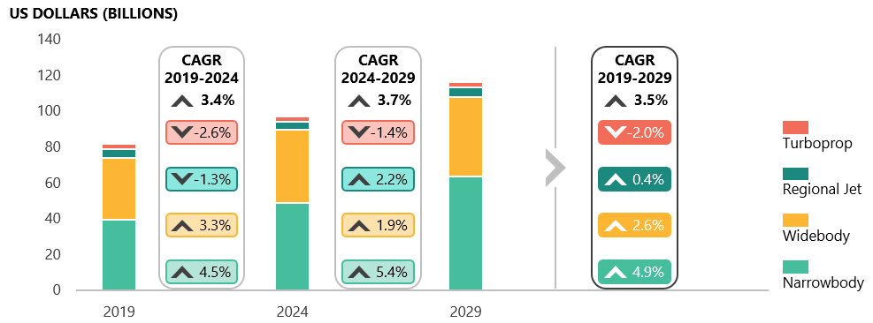
Helicopter Summit – “Enhancing Connectivity through Helicopters”
MRO MARKET FORECAST BY AIRCRAFT CLASS, 2019–2029
Helicopter Summit - 2019

Slide 16
Helicopter Summit – “Enhancing Connectivity through Helicopters”
 | Global MRO | Indian MRO | Domestic MRO Done | Helicopter MRO/Indian MRO | Helicopters MRO / Domestic MRO Done
2019 | $82 billion | $ 2 billion/ 2.4% | $ 0.7 billion/30% | $ 75 million/(3.75%) | $ 75 million/10.7%
2029 | $116 billion | $ 4 billion/3.4% | $ 1.2 billion (30%) $ 2 billion (50%) | $ 150 million (3.75%) $ 600 million (15%) | $ 150 million/12.50% $ 600 million (30%)
Helicopter Summit - 2019

Slide 17
Opportunities for the growth of MRO Industry - India
New Civil Aviation Policy - 2016 has enumerated several progressive steps for MROs viz:
VAT reduction in persuasion with State Govts.
No airport royalties and charges for five years and further rationalization.
Declaring MRO as a Separate Category.
Duty free storage of imported spare parts.
Exemption of customs duty on aircraft tools, tool-kits and testing equipment etc.
Allowed import of unserviceable parts for maintenance.
Relaxed rules for foreign aircraft maintenance in India.
Easing out several irritant customs and regulatory provisions.
NCAP Policy would give strong positive push to performance and expansion of MRO establishments.
Helicopter Summit - 2019

Slide 18
Helicopter Summit – “Enhancing Connectivity through Helicopters”
Higher duties of approximately 12-15% on spare parts.
Rents charged by Airports to MRO providers are 50-100% higher than the facilities in Europe and Turkey.
High GST of 18%.
Policy interventions to propel MRO as per 2019-2020 Union Budget
Providing a level playing field through suitable tax related interventions
Rationalising royalty payments for MROs at Airports
Strategic push for setting up engine shops in India
Creating a bonded warehouse or depository of spare parts for timely availability to suit best turnaround times.
Helicopter Summit - 2019

Slide 19
Helicopter Summit – “Enhancing Connectivity through Helicopters”
Issues that Create Headwinds for Indian Aviation
Tax on Aviation Turbine Fuel.
Limited runway capacity.
Costs of new airport capacity are unrestrained.
Restructuring of regulatory bodies.
Legal procedures where contract enforcement is challenging.
Sustainability and Success of UDAN Scheme.
Helicopter Summit - 2019

Slide 20
Helicopter Summit – “Enhancing Connectivity through Helicopters”
FACTORS AFFECTING AVIATION INDUSTRY & MRO
Helicopter Summit - 2019

Slide 21
Helicopter Summit – “Enhancing Connectivity through Helicopters”
Thank you
Corp.affairs@pawnhans.co.in
Pawanhans.co.in
Let the Transformation
Begin
Helicopter Summit - 2019

Slide 22
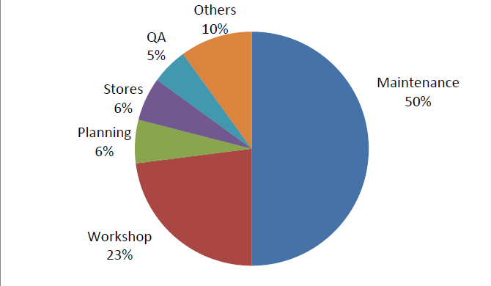
Helicopter Summit – “Enhancing Connectivity through Helicopters”
Human resource functional break-up of MRO: 12 employees per aircraft
MRO Market Size | Annual | India | Abroad | Helicopters
Current (2018-19) | Rs.5000 Cr | Rs. 500 Cr (10%) | Rs 4,500 Cr (90%) | Rs. 525 Cr.
Year 2025 | Rs. 13,950 Cr | Rs. 8,370 Cr (60%) | Rs. 5,580 Cr (40%) | Rs. 1100 Cr.
Year 2035 | Rs 20,900 Cr | Rs. 15,693 Cr (75%) | Rs. 5,225 Cr (25%) | Rs. 2000 Cr.
Helicopter Summit - 2019

Slide 23
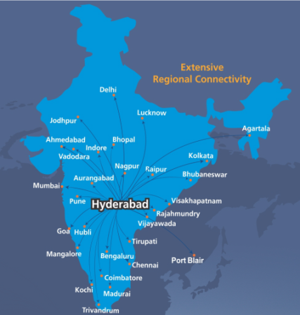
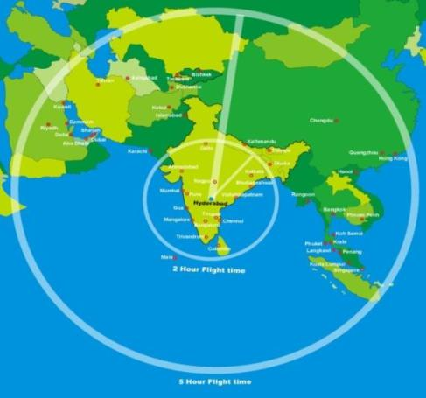
INTERNATIONALLY WELL LOCATED & DOMESTICALLY WELL CONNECTED LOCATION
Within 2 Hours flying time
Kathmandu | Male
Colombo | Dhaka
Within 5 Hours flying time
Abu Dhabi | Muscat | Penang
Dammam | Riyadh | Phuket
Doha | Sharjah | Singapore
Dubai | Bangkok | Mauritius
Kuwait | Kuala Lumpur

Slide 24
Helicopter Summit – “Enhancing Connectivity through Helicopters”
FLEET AND MRO FORECAST SUMMARY
REGION | AFRICA | MIDDLE EAST | ASIA PACIFIC | CHINA | INDIA | LATIN AMERICA | NORTH AMERICA | EASTERN EUROPE | WESTERN EUROPE | WORLD
2019 FLEET
NARROWBODY | 460 | 564 | 2,152 | 2,819 | 460 | 1,085 | 4,208 | 896 | 3,294 | 15,938
WIDEBODY | 179 | 781 | 1,383 | 414 | 67 | 177 | 1,277 | 153 | 1,057 | 5,488
REGIONAL JET | 159 | 66 | 220 | 143 | 4 | 273 | 1,905 | 241 | 466 | 3,477
TURBOPROP | 327 | 29 | 655 | - | 73 | 236 | 643 | 124 | 502 | 2,589
TOTAL | 1,125 | 1,440 | 4,410 | 3,376 | 604 | 1,771 | 8,033 | 1,414 | 5,319 | 27,492
2029 FLEET
NARROWBODY | 749 | 906 | 3,803 | 6,146 | 1,177 | 1,582 | 5,493 | 1,169 | 4,752 | 25,777
WIDEBODY | 340 | 1,278 | 1,817 | 780 | 149 | 364 | 1,694 | 240 | 1,383 | 8,045
REGIONAL JET | 73 | 47 | 415 | 261 | 13 | 277 | 1,624 | 252 | 365 | 3,327
TURBOPROP | 163 | 46 | 594 | 22 | 208 | 164 | 436 | 82 | 311 | 2,026
TOTAL | 1,325 | 2,277 | 6,629 | 7,209 | 1,547 | 2,387 | 9,247 | 1,743 | 6,811 | 39,175
Helicopter Summit - 2019

Slide 25
Helicopter Summit – “Enhancing Connectivity through Helicopters”
FLEET AND MRO FORECAST SUMMARY
REGION | AFRICA | MIDDLE EAST | ASIA PACIFIC | CHINA | INDIA | LATIN AMERICA | NORTH AMERICA | EASTERN EUROPE | WESTERN EUROPE | WORLD
2019–2024 | 1.5% | 5.0% | 4.9% | 9.6% | 12.1% | 2.7% | 1.3% | 2.6% | 2.7% | 3.9%
2024–2029 | 1.8% | 4.4% | 3.4% | 6.2% | 7.7% | 3.4% | 1.6% | 1.7% | 2.3% | 3.3%
2019–2029 | 1.6% | 4.7% | 4.2% | 7.9% | 9.9% | 3.0% | 1.4% | 2.1% | 2.5% | 3.6%
Helicopter Summit - 2019

Slide 26
Helicopter Summit – “Enhancing Connectivity through Helicopters”
FLEET AND MRO FORECAST SUMMARY
REGION | AFRICA | MIDDLE EAST | ASIA PACIFIC | CHINA | INDIA | LATIN AMERICA | NORTH AMERICA | EASTERN EUROPE | WESTERN EUROPE | WORLD
2019 MRO (US$ BILLIONS)
AIRFRAME | $0.9 | $1.5 | $3.7 | $2.2 | $0.7 | $1.1 | $5.2 | $1.3 | $4.6 | $21.1
ENGINE | $0.9 | $5.6 | $7.1 | $2.2 | $0.7 | $1.5 | $7.8 | $1.6 | $6.0 | $33.4
COMPONENT | $0.4 | $0.9 | $2.2 | $1.3 | $0.3 | $0.8 | $4.1 | $0.7 | $2.9 | $13.8
LINE | $0.3 | $1.0 | $2.3 | $1.5 | $0.3 | $0.7 | $3.4 | $0.7 | $3.4 | $13.7
TOTAL | $2.6 | $9.0 | $15.3 | $7.2 | $2.0 | $4.1 | $20.5 | $4.3 | $16.9 | $81.9
2029 MRO (US$ BILLIONS)
AIRFRAME | $0.8 | $2.1 | $4.7 | $4.2 | $0.9 | $1.2 | $5.2 | $1.2 | $4.7 | $25.0
ENGINE | $1.3 | $8.0 | $8.5 | $7.3 | $1.6 | $2.3 | $10.3 | $2.0 | $8.7 | $50.0
COMPONENT | $0.7 | $1.5 | $3.6 | $3.6 | $0.9 | $1.2 | $4.7 | $1.1 | $3.7 | $21.0
LINE | $0.5 | $1.5 | $3.4 | $3.3 | $0.7 | $1.0 | $4.2 | $0.9 | $4.4 | $20.0
TOTAL | $3.4 | $13.1 | $20.3 | $18.3 | $4.0 | $5.6 | $24.5 | $5.2 | $21.5 | $116.0
Helicopter Summit - 2019

Slide 27
Helicopter Summit – “Enhancing Connectivity through Helicopters”
FLEET AND MRO FORECAST SUMMARY
REGION | AFRICA | MIDDLE EAST | ASIA PACIFIC | CHINA | INDIA | LATIN AMERICA | NORTH AMERICA | EASTERN EUROPE | WESTERN EUROPE | WORLD
MRO GROWTH RATES
2019–2024 | 1.4% | 3.8% | 3.6% | 11.0% | 6.0% | 3.1% | 1.1% | 2.1% | 2.4% | 3.4%
2024–2029 | 4.1% | 3.9% | 2.1% | 8.5% | 8.2% | 3.3% | 2.5% | 1.9% | 2.5% | 3.7%
2019–2029 | 2.7% | 3.9% | 2.9% | 9.7% | 7.1% | 3.2% | 1.8% | 2.0% | 2.5% | 3.5%
Helicopter Summit - 2019

Slide 28
Helicopter Summit – “Enhancing Connectivity through Helicopters”
MRO Market Forecast – Rotary Wing
Helicopter Summit - 2019

Slide 29
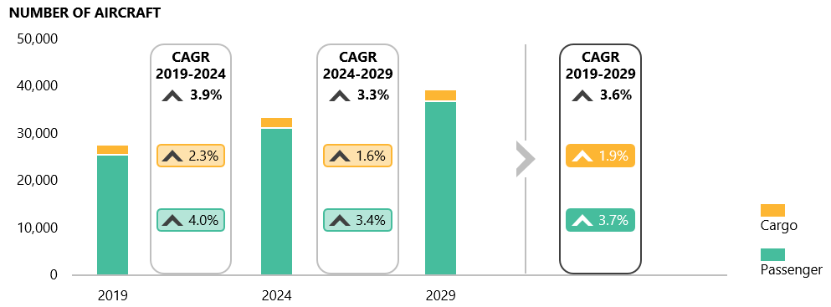
Helicopter Summit – “Enhancing Connectivity through Helicopters”
GLOBAL FLEET FORECAST BY AIRCRAFT USAGE, 2019–2029
Helicopter Summit - 2019

Slide 30
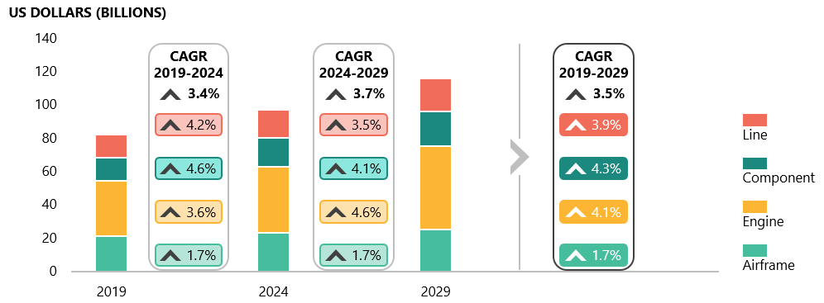
Helicopter Summit – “Enhancing Connectivity through Helicopters”
GROWTH OF MRO SPEND, 2019–2029
Helicopter Summit - 2019

Slide 31
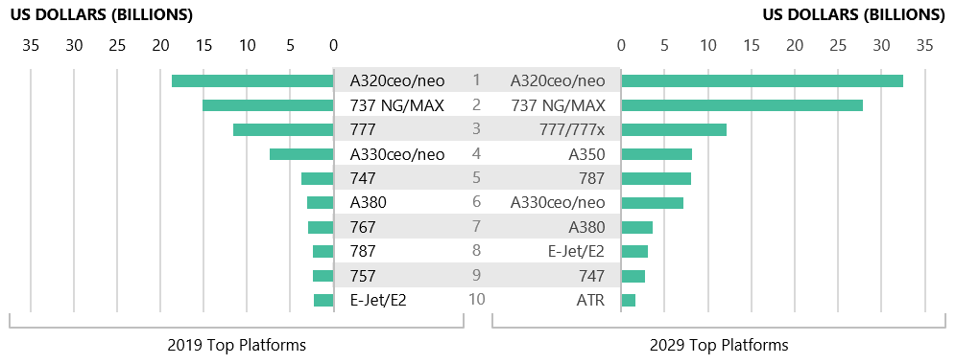
Helicopter Summit – “Enhancing Connectivity through Helicopters”
TOP AIRCRAFT PLATFORMS BY TOTAL MRO SPEND
Helicopter Summit - 2019

Slide 32
One of the fastest growing industry in India
Aviation Industry
CAGR
FY14
FY18
Scheduled aircrafts
in operation
395
496
8%
Favourable Dynamics
Total Passenger traffic – Domestic and International (Cr.)
10.4
15.9
India’s strong GDP growth 7.1% in 2017
Rising per capita income in India: Rs. 1.0 lakh (FY17) vs. Rs.0.6 lakh (FY10)
Travel & Tourism is a Rs. 9.4 lakh crore strong industry
Strong policy support: NCAP
5) Rs. 77k Crore worth investments made in the airport sector from FY2012-17;
6) Developed 1st Integrated Heliport at Delhi
15%
Non-scheduled aircrafts in operation
361
406
4%
No. of aircraft hours flown
(lakh hrs.)
14.2
19.4
11%
No of helicopters in operation
280
240
-14%
No of helicopter hours flown
(in lakhs hours)
0.89
0.72
-18%
Helicopter Summit - 2019

